Slide 1
Airmail, installing and configuring for Internet Mail
Yamhill County ARES 2014

Slide 2
Downloading Airmail
The latest version of Airmail is available at: http://siriuscyber.net/ham/
Download the version Airmail ver 3.4.062
If you will be Opening it or Running it when you download, make sure are logged into the computer with Administrator rights.

Slide 3
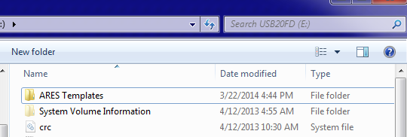
Copying it off the flash drive
Open the Flash drive folders.
Click and Drag the “ARES Templates” folder onto your Desktop.
The folder also contains the blank “template” email types used by the OADN.

Slide 4
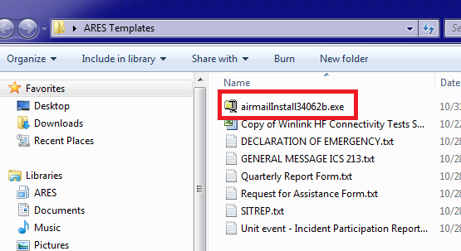
Open ARES Templates and run the installer
Double click on the ARES Template folder
Double click on the airmailInstall34062b.exe file

Slide 5
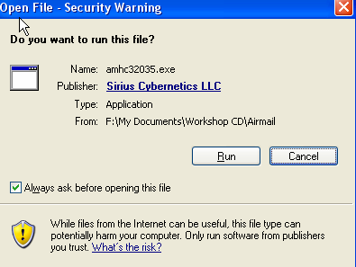
Beginning the installation
Select Run to start the installation
Select Setup to start the self extractor and installer.

Slide 6
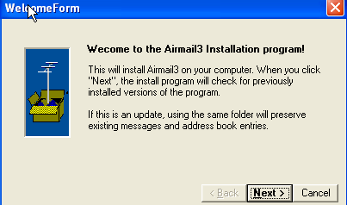
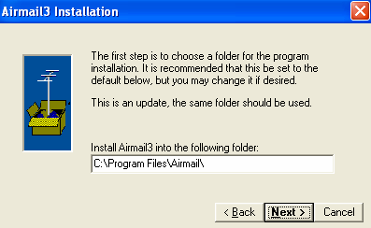
Starting the install process
Click NEXT on the next two boxes.
Do NOT change the installation folder!

Slide 7
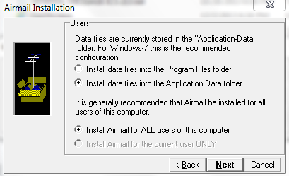
Data folder decisons
Windows 7 should be in Application Data.
Older versions of Windows should be in Program Files.
Install for ALL Users, so that you can use the program when not in Admin mode!

Slide 8
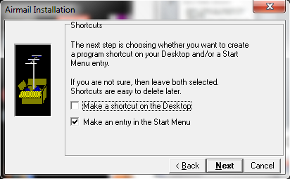
Shortcuts?
Personal decision, do you want an airmail icon on the desktop?
Yes, you want one in the start menu at least!

Slide 9
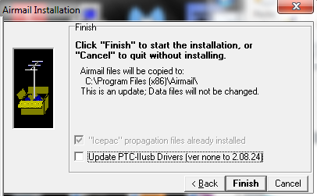
Finishing the install
Uncheck the box for Update the PTC-Iiusb Drivers UNLESS you have this TNC. (unlikely if you are reading this).
Check the box for “Icepac” propagation. Just in case you ever have a TNC and a HF setup.
Click Finish

Slide 10
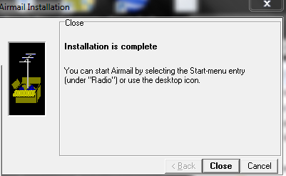
Ending the installation
Click Close to end the install.
Interesting Note here, the program resides in a folder called “Radio” in the start menu. If you cannot find it later, remember Airmail has to do with Radio mail.

Slide 11
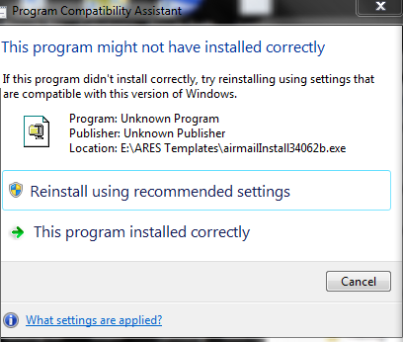
OH NO, AN ERROR?
Not really an error, the installer does not contain some Windows 7 “reqs” so it throws up this nasty message.
Just select “This program installed correctly”

Slide 12
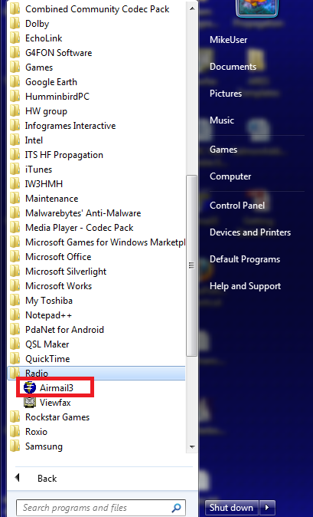
Time to open the program
Click on your START button, select All Programs or Programs
Go to the Radio folder and click on AIrmail3

Slide 13
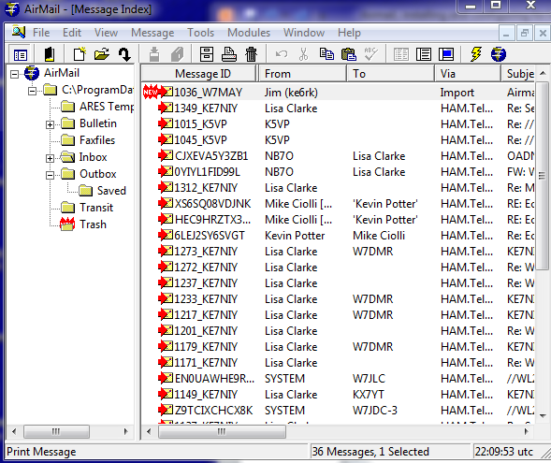
The Main Airmail page
Four main areas.
File and Task bar for common functions
Left pane for your folders and organizing.
Right pane for the emails in the open folder.

Slide 14
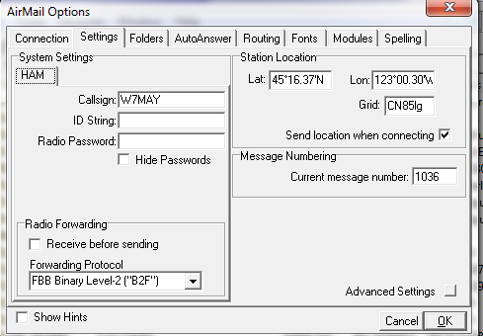
Lets set up Airmail!
Across the top of the screen select “Tools” then “Options”,click on the “Settings” tab.
Enter your Call Sign!!
You can enter your Lat, Long, and Maidenhead Grid if you know them. If not, do it later.

Slide 15
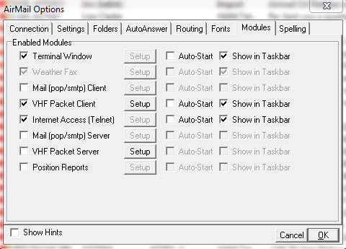
Time to set up Modules!!
Click on the “Modules” tab.
Check the “Terminal Window” and the “Internet Access (Telnet)” boxes, click OK.

Slide 16
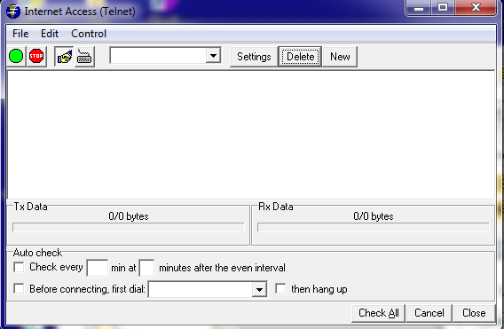
Set up Telnet (Internet mail)
Across the top of the screen, click “Modules” then “Internet Access”.
Before you can make a connection, you have to set up a server, select “New”.

Slide 17
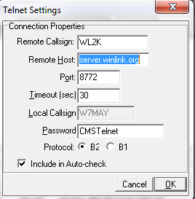
Configure the server
Just need to set up the WL2K server!!

Slide 18
Are there other servers?
Sort of. The WL2K server automatically routes you to the “best” node to use.
WL2KS (San Diego server)
Remote host sandiego.winlink.org
WL2KH (Halifax server)
halifax.winlink.org
WL2kP (Perth server)
perth.winlink.org
All use port 8722, 30 second timeout, password CMSTelnet, B2 for the protocol.

Slide 19
Write W7MAY mail.
Close the Telnet window to return to the main screen.
Click on the symbol to create a new message.
Click Cancel on the address book.
Address it to W7MAY, pick a subject, put in whatever you wish in the body.
Click on the symbol to post the message for sending.

Slide 20
Send Internet Mail
Click on the symbol to open the Telnet screen.
Verify you have WL2K selected for the server.
Verify the “handshake” is depressed.
Click the green circle to start a telnet session.
That SHOULD be all there is to it.

Slide 21
One potential GOTCHA!!
A firewall can block access to the Internet. It happened to me, it can happen to you.
Click your START and select Control Panel
Select “System and Security”.
Under Windows Firewall select “Allow a program through Windows Firewall”
Put a check mark on AIrmail3, and a check on Home/Work, then OK.

Slide 22
Ready to use Airmail?
Probably not, but you are ready to start experimenting with it.
You can send to standard email addresses. Try sending yourself some test mails.
Occasionally, the WinLink server will block and email unless you put //WL2K at the start of the subject line.
If you know a Ham uses Airmail, just type in the call sign.
Your winlink email address is “callsign@winlink.org”

Slide 23
Questions?
Have a great evening, see you next month where the training will be??????

